Slide 1
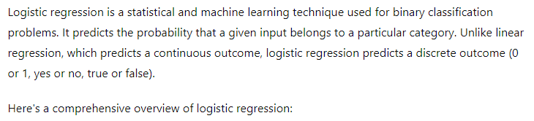
Logistic Regression

Slide 2
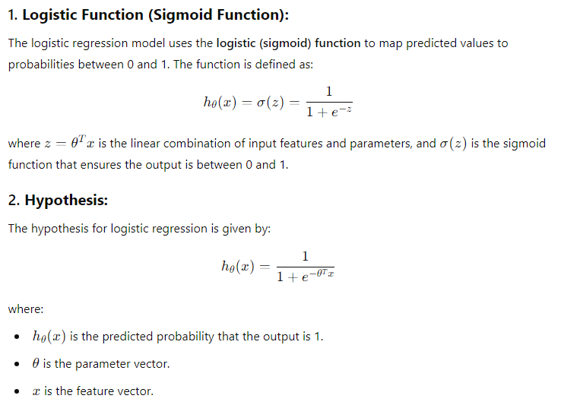
Key Concepts

Slide 3
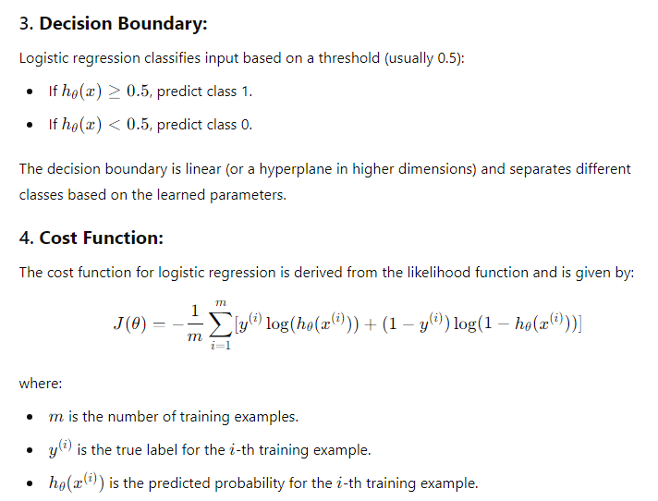
Key Concepts

Slide 4
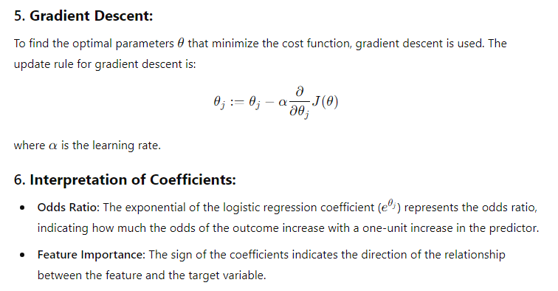
Key Concepts

Slide 5
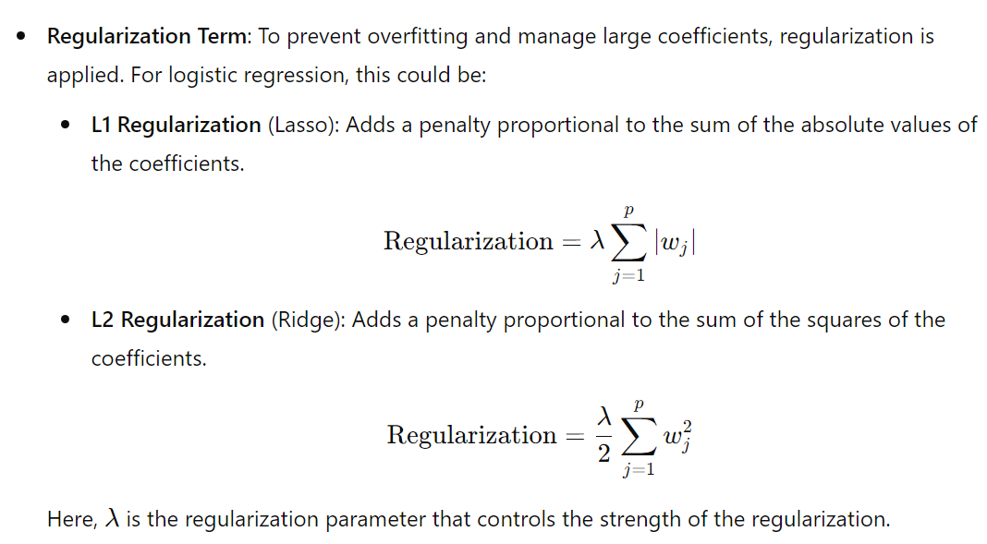
Regularization

Slide 6
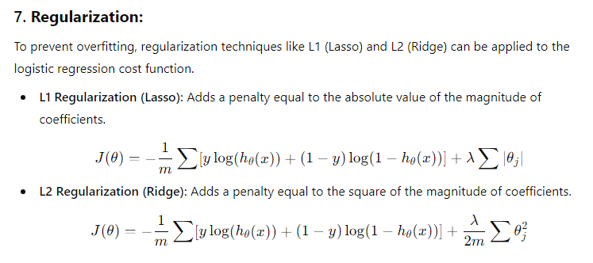
Key Concepts

Slide 7
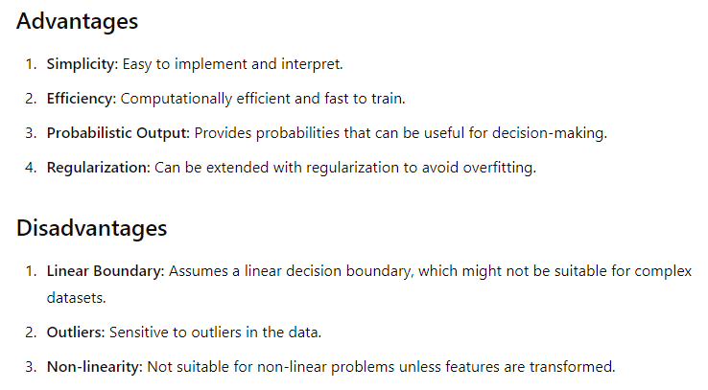
Merits and Demerits

Slide 8
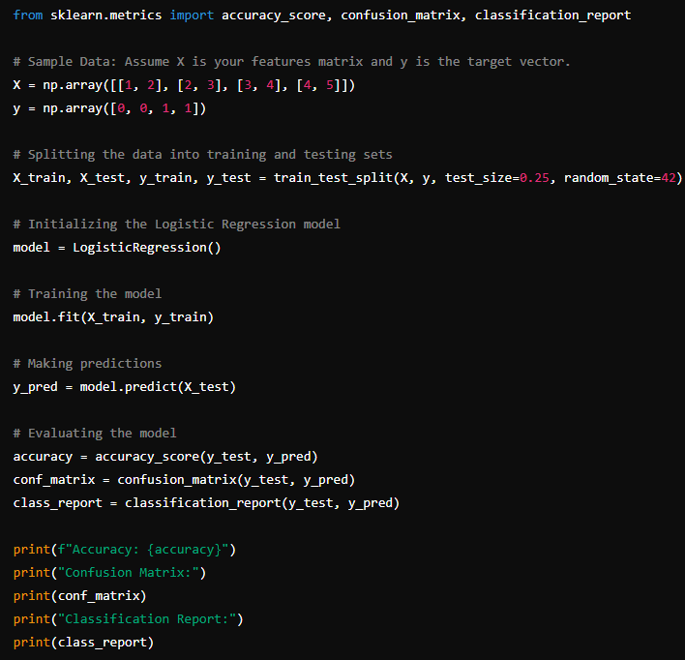
Logistic Regression : Python Code

Slide 9
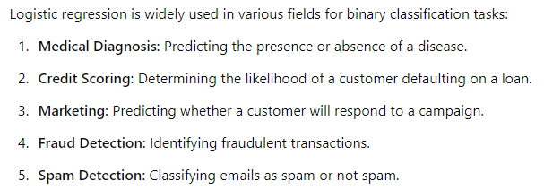
Applications

Slide 10
Multinomial Logistic Regression (Softmax Regression)
Multinomial Logistic Regression, also known as Softmax Regression, is a generalization of logistic regression that allows for the classification of more than two classes.
While logistic regression is used for binary classification problems, Softmax Regression extends this concept to handle multiple classes, making it suitable for multi-class classification problems.

Slide 11
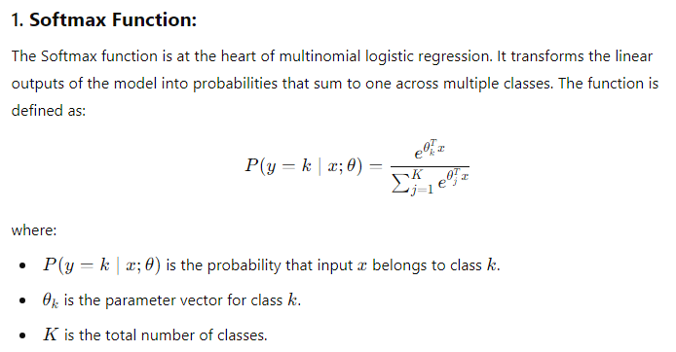
Key Concepts

Slide 12
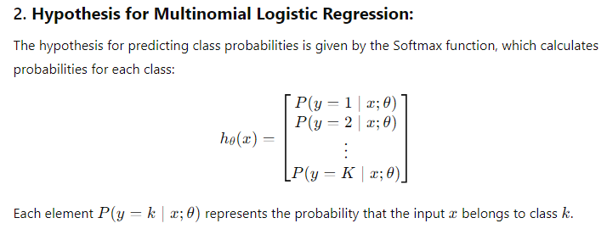
Key Concepts

Slide 13
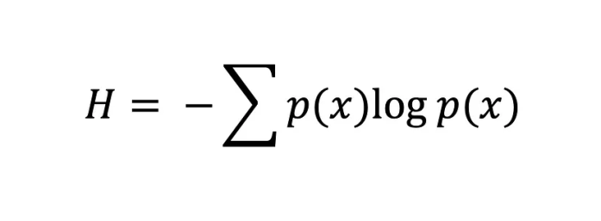
Loss Function
Cross Entropy loss function is used.
Information entropy, also known as Shannon entropy, calculates the degree of randomness or disorder within a system.
In the context of information theory, the entropy of a random variable is the average uncertainty to the possible outcomes.
The entropy function is:
The greater the value of entropy, H(x), the greater the uncertainty for the probability distribution, and the smaller the value, the less uncertainty.

Slide 14
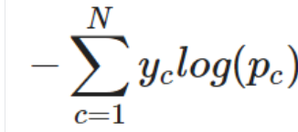
Cross-entropy
Cross-entropy, also known as logarithmic loss or log loss, is a popular loss function used in machine learning to measure the performance of a classification model.
We can measure the error between two probability distributions using the cross-entropy loss function.
For a multi-class classification task, cross-entropy is defined as follows:
In other words, to apply cross-entropy to a multi-class classification task, the loss for each class is calculated separately and then summed to determine the total loss.

Slide 15
Cross Entropy Loss
Softmax and Cross-entropy are commonly used together in a multi-class classification problem, where the goal is to identify which class an input belongs to.
Softmax function is used to transform the output of a model into a probability distribution over all the classes and
Cross-entropy is used as a loss function to measure how well the predicted probability distribution matches the actual class labels.
The objective function is a combination of the cross-entropy loss and a regularization term to prevent overfitting.

Slide 16
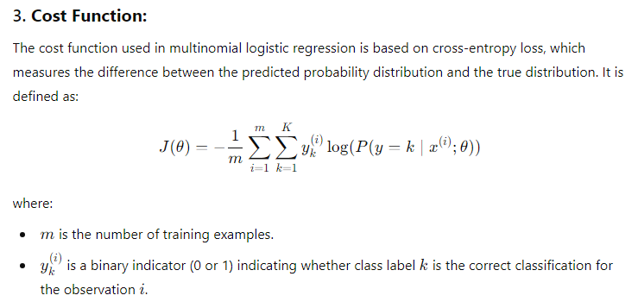
Key Concepts

Slide 17
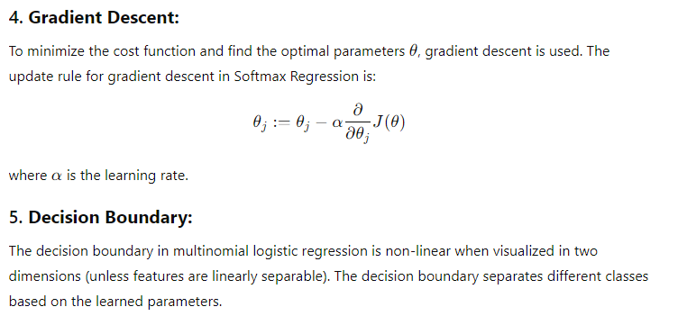
Key Concepts

Slide 18
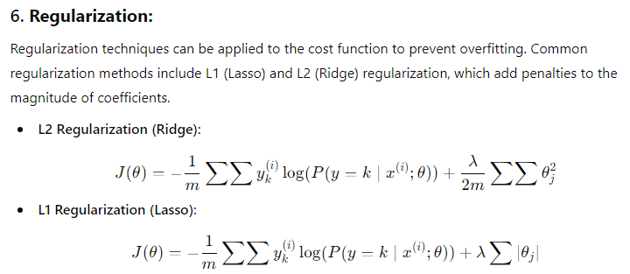
Key Concepts
L1 regularization can lead to sparse solutions, effectively performing feature selection, while L2 regularization tends to shrink coefficients but keeps all features.

Slide 19
For L1 regularization, coordinate descent is often used. This involves updating one parameter at a time while keeping others fixed, which can efficiently handle the sparsity introduced by L1 regularization.

Slide 20
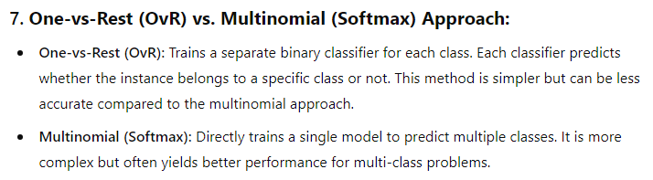
Key Concepts

Slide 21
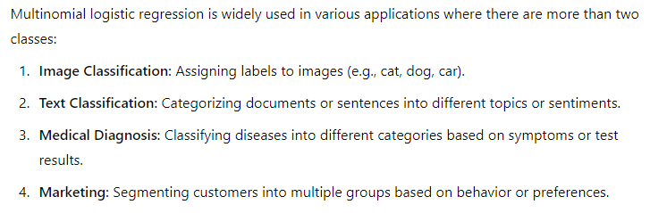
Applications

Slide 22
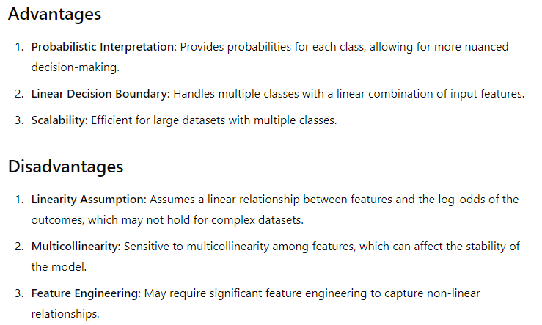
Merits and Demerits

Slide 23
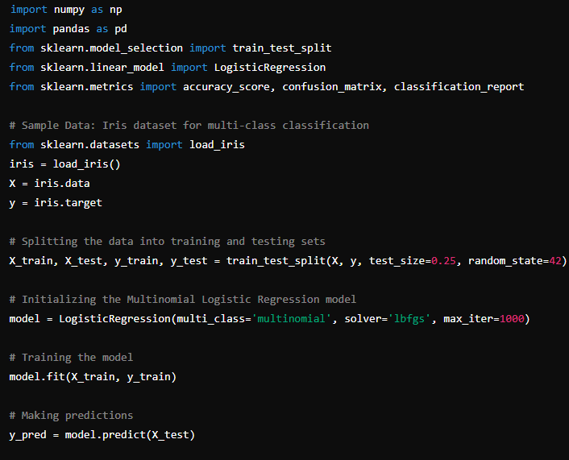
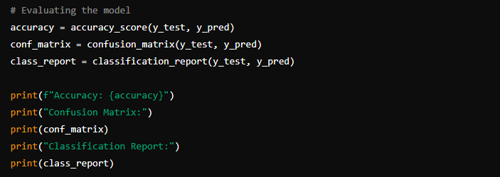
Python Code

Slide 24
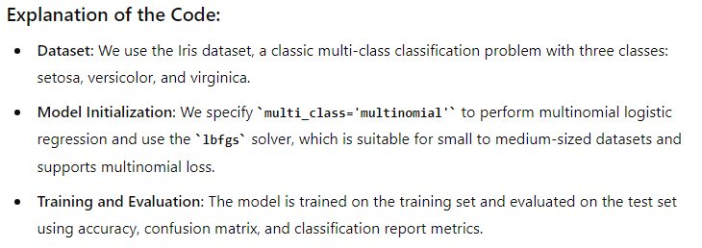
Code Explanation

Slide 25
Different solvers in logistic regression
In logistic regression, the choice of solver is crucial because it affects the algorithm's convergence, speed, and accuracy.
Solvers are optimization algorithms used to minimize the cost function and find the best-fitting model parameters.
Different solvers may be better suited for specific types of data and regularization techniques.

Slide 26
Liblinear Solver
The Liblinear solver is used in logistic regression to efficiently handle large-scale datasets and problems with high-dimensional features.
Liblinear is optimized for sparse datasets. It efficiently handles large datasets where most of the feature values are zero.
Parameter Tuning: The Liblinear library includes methods for tuning hyperparameters, such as the regularization parameter, to optimize model performance.

Slide 27
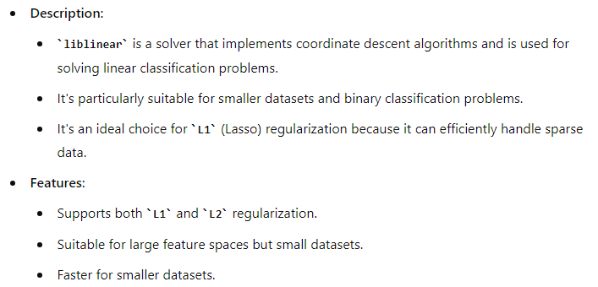
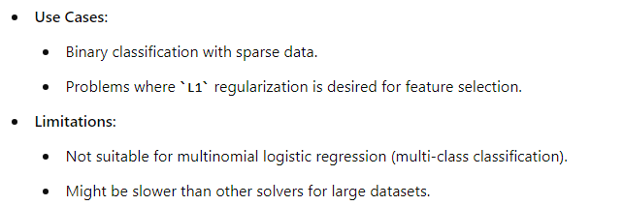
1. Liblinear

Slide 28
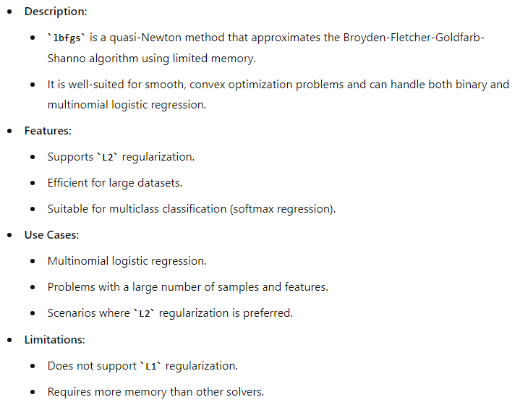
2. LBFGS (Limited-memory Broyden-Fletcher-Goldfarb-Shanno)

Slide 29
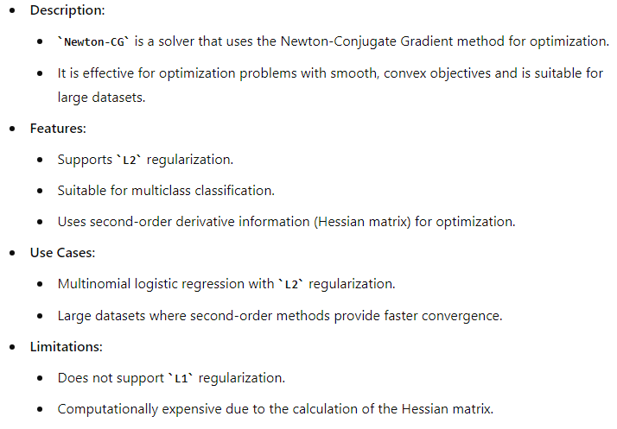
3. Newton-CG

Slide 30
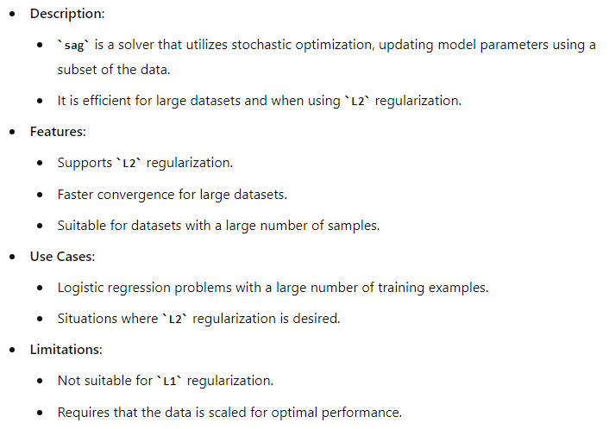
4. SAG (Stochastic Average Gradient)

Slide 31
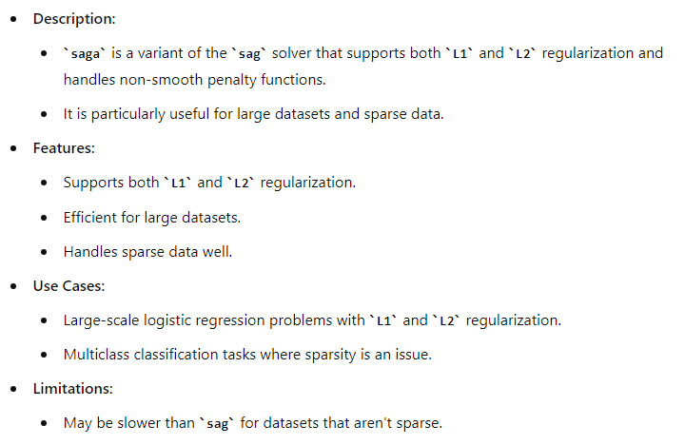
5. SAGA(Stochastic Average Gradient Augmented)

Slide 32
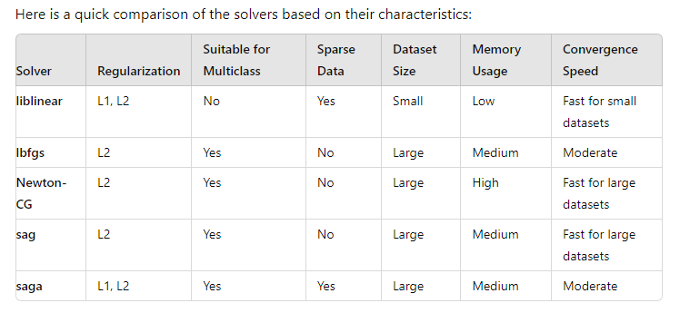
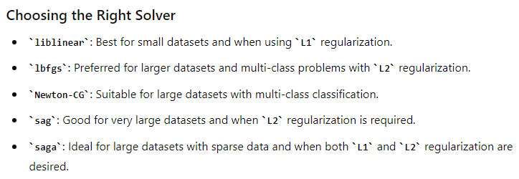
Comparison of Solvers

Slide 33
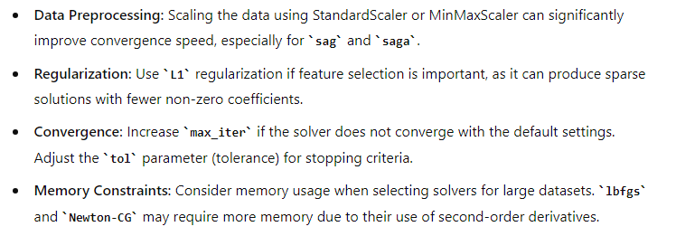
Practical Tips

Slide 34
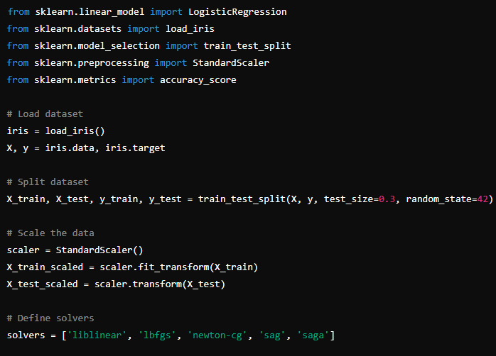
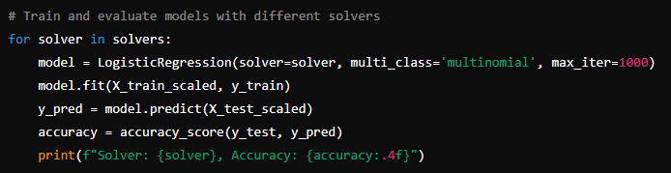
Pythone Code

Slide 35
Conclusion
Logistic regression is a fundamental tool in machine learning for binary classification tasks.
Its simplicity, interpretability, and effectiveness make it a popular choice for many applications.
However, it's essential to understand its assumptions and limitations, especially when dealing with non-linear data or when more complex decision boundaries are needed.

Slide 36
Conclusion
Multinomial Logistic Regression (Softmax Regression) is a powerful tool for multi-class classification tasks.
Its ability to handle multiple classes with a probabilistic approach makes it versatile for a wide range of applications.
However, it is essential to consider its assumptions and limitations, especially regarding linearity and feature relationships.

Slide 37
Conclusion
Choosing the right solver for logistic regression is essential for achieving the best performance and efficiency.
Consider the dataset size, type of regularization, and specific requirements when selecting a solver.
By understanding the characteristics and use cases of each solver, we can make informed decisions to optimize our logistic regression models.

Slide 38
THANK YOU

